Slide 1
Technical English for Computer Science
Week 8
Dr. Nur Banu OĞUR

Slide 2
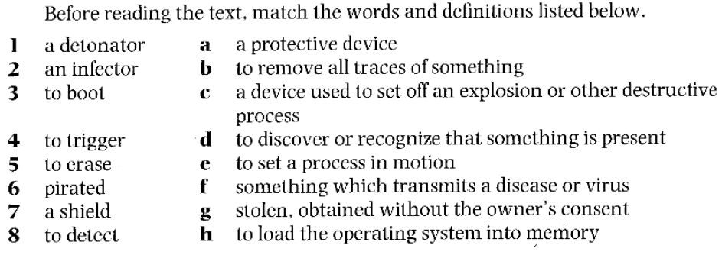
How Computer Viruses Work

Slide 3
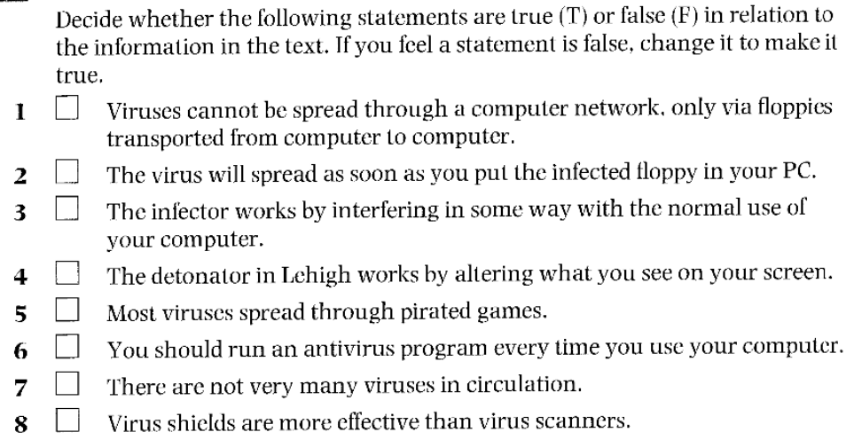
How Computer Viruses Work

Slide 4
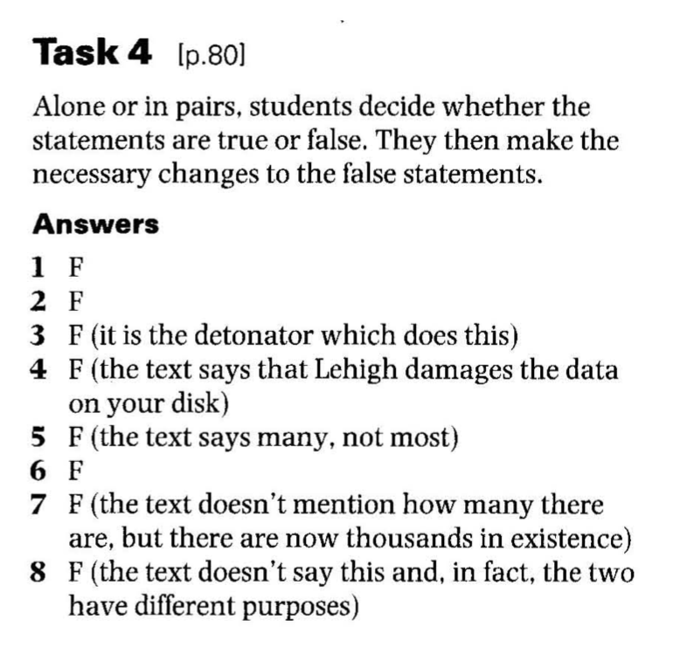

Slide 5
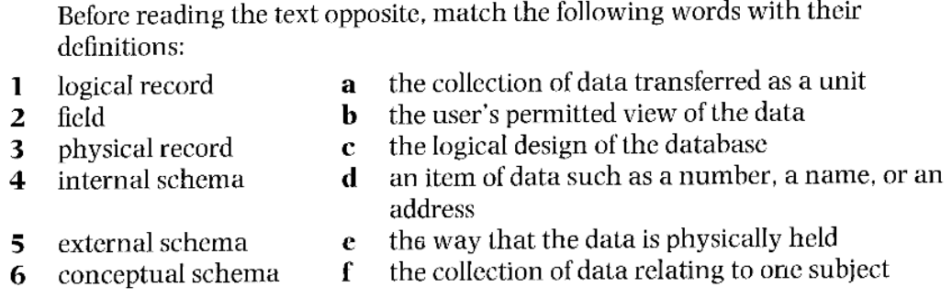
Data Storage and Management

Slide 6
Cross-Word

Slide 7
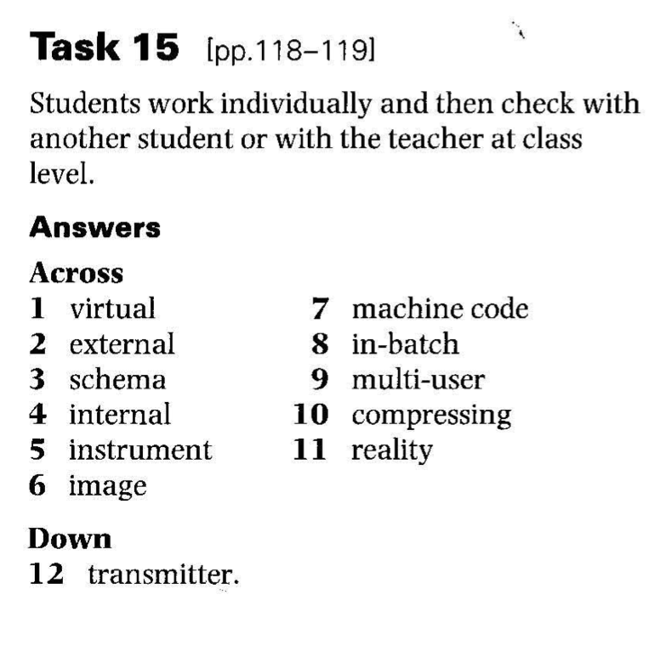

Slide 8
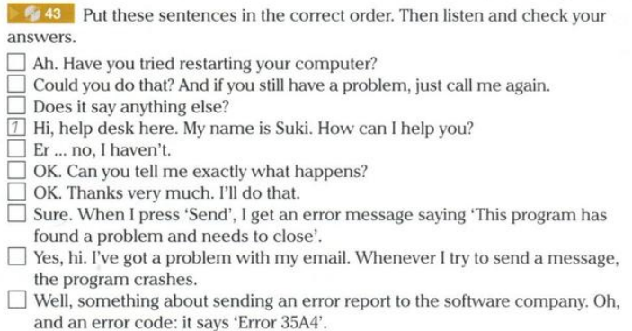

Slide 9
Translate!

